Slide 1

Operating Systems Design​ Session 21: Memory Management Introduction
19CS2106R​
© 2020 KL University

Slide 2
CO3 – Memory Management

Slide 3
0KB
Multiprogramming
Operating System
(code, data, etc.)
0KB
64KB
Operating System
(code, data, etc.)
Free
128KB
Load multiple processes in memory.
Execute one for a short while.
Switch processes between them in memory.
Increase utilization and efficiency.
Process C
(code, data, etc.)
64KB
Current
Program
(code, data, etc.)
192KB
Process B
(code, data, etc.)
256KB
Free
320KB
Process A
(code, data, etc.)
448KB
We need to have some kind of mechanism which can store one process at different locations of the memory.
Free
512KB
max
Physical Memory
Process D
(code, data, etc.)
164KB
Uniprogramming:
One process runs at a time

Slide 4
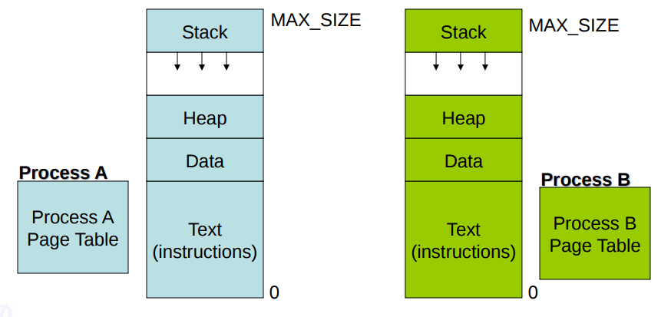
Process Address Space
To help enforce isolation, A process provides a program with what appears to be a private memory system, or address space, which other processes cannot read or write.
Each process has a different address space. This is achieved by the use of virtual memory, i.e. 0 to MAX_SIZE are virtual memory addresses.
For any process to execute on the CPU, the corresponding instructions and data must be available in main memory
The OS tries to ensure that running processes reside in memory as far as possible.

Slide 5
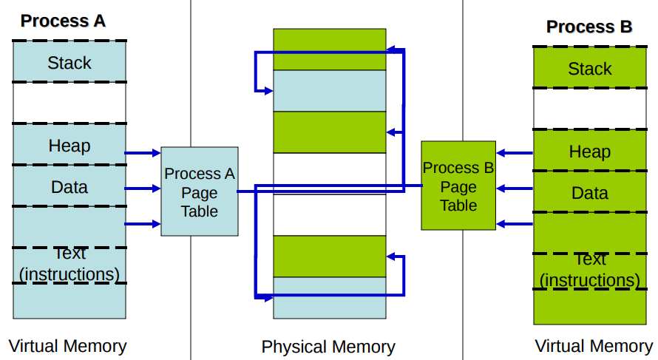
Paging
The Idea behind paging is to divide the process in pages so that, we can store them in the memory at different non contiguous location
The logical address space of every process is divided into fixed-size (e.g., 4KB) chunks called pages.
The physical memory is divided into fixed size chunks called frames, which are typically the same size as pages.
A page table of a process maintains this mapping from logical page numbers to physical frame numbers.
The operating system maintains a separate page table for every process it creates

Slide 6
Physical Address Space

Slide 7
Physical Memory (RAM)
Unused Address Space –
Memory Mapped
Depends on addressing Bits
Low memory is also called conventional memory.
640 KB to 1MB used by video buffers, expansion ROMS, BIOS ROMs
1 MB onwards called extended memory
Extended Memory …
Actual Physical memory Size
Depends on Physical Memory
0x00100000 (1 MB)
BIOS ROM
0x000F0000 (960 KB)
16 Bit Devices Expansion ROM
0x000C0000 (768 KB)
VGA Display
0x000A0000 (640 KB)
Low Memory (640KB) –
DOS Memory
0x00000000

Slide 8
I/O Addressing
Each I/O device connected to your computer is mapped to a unique I/O (Input/Output) address.
Input/output to be performed in either of two ways:
A Separate I/O Address Space (I/O Ports) - 1024
Memory Mapped I/O
Who decides the address ranges?
Standards / Legacy
Such as the IBM PC standard, Ensures BIOS and OS to be portable across platforms
Plug and Play devices
Address range set by BIOS or OS

Slide 9
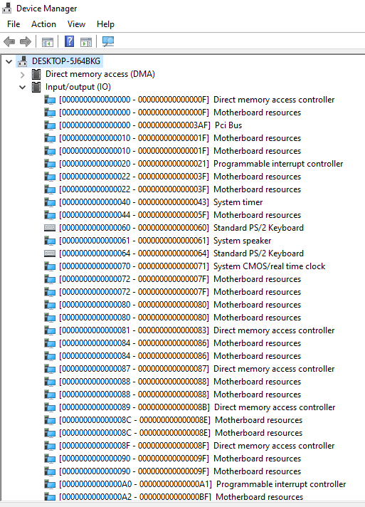
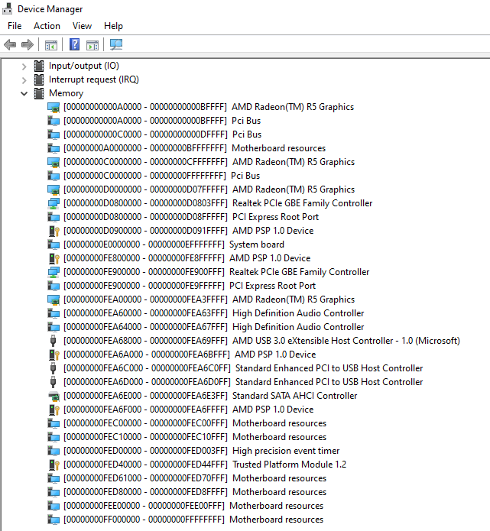
I/O Ports
Range : 0 to 2¹⁶-1
Used to access devices
All configured ports on the system must be unique.
Some devices always have default I/O port assigned.
0x00100000 (1 MB)
BIOS ROM
0x000F0000 (960 KB)
16 Bit Devices Expansion ROM
0x000C0000 (768 KB)
VGA Display
0x000A0000 (640 KB)
Low Memory (640KB) –
DOS Memory
0x00000000

Slide 10
System and User Space for 32 Bit systems
Depends on Physical Memory
4GB Physical Memory
ZONE_DMA: This is used for old ISA buses
ZONE_NORMAL: The kernel can map/access directly.
ZONE_HIGHMEM: Page frames from the user space can be temporarily or permanently mapped here.
Extended Memory …
Actual Physical memory Size
ZONE_HIGHMEM
ZONE_NORMAL
896 MB
ZONE_DMA
16 MB
0x00100000 (1 MB)
Notes:
Part of memory is reserved for kernel data structures that store information about the memory map and page tables. This on x86 is 128 MB.

Slide 11
Kernel Space and User Space for 32 Bit systems
Linux
1 GB Kernel Space
3 GB User Space
Windows (32 Bit) - Default
2 GB System Space
2 GB User Space
Windows (32 BIT) - 4-gigabyte tuning (4GT)
1 GB System Space
3 GB User Space
Depends on Physical Memory
4GB Virtual Memory Example
Extended Memory …
Actual Physical memory Size
Kernel Space
User Space
0x00100000 (1 MB)

Slide 12
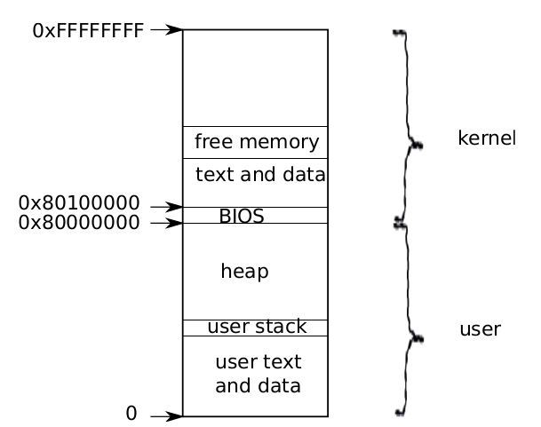
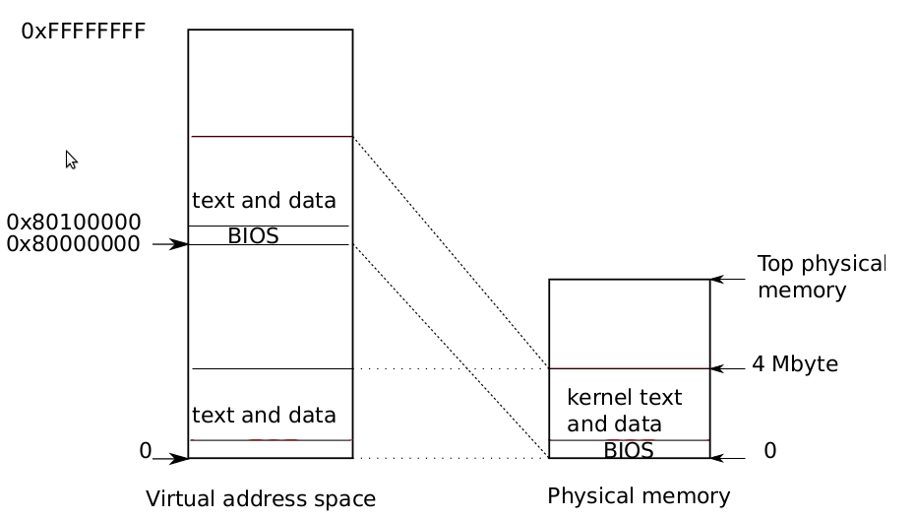
Kernel Space and User Space for XV6
Layout of a virtual address space

Slide 13
Booting

Slide 14
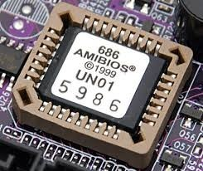
Powering up : Reset
Physical address = Code Segment + Instruction Pointer
= (CS << 4) + IP = 0xffff0
first instruction fetched from location 0xffff0
Power on Reset
Does the following
Power on self test
Initialize video card and other devices
Display BIOS screen
Perform brief memory test
Set DRAM memory parameters
Configure Plug & Play devices
Assign resources (DMA channels & IRQs)
Identify the boot device
Read sector 0 from boot device into memory location 0x7c00
Jumps to 0x7c00
Every register initialized to 0 except
CS=0xf000, IP=0xfff0
0x00100000 (1 MB)
BIOS ROM
0x000F0000 (960 KB)

Slide 15
Powering up : MBR
Sector 0 in the disk called Master Boot Record (MBR)
Contains code that boots the OS or another boot loader
Copied from disk to RAM (@0x7c00) by BIOS and then begins to execute
Size 512 bytes
446 bytes bootable code
64 bytes disk partition information (16 bytes per partition) 2 bytes signature
Typically, MBR code looks through partition table and loads the bootloader (such as Linux or Windows) or, it may directly load the OS
15

Slide 16
Powering Up : bootloader
May also allow the user to select which OS to load (eg. Windows or Linux)
Disable interrupts
Switch from real mode to protected mode
Read operating system from disk
•
Name of the bootloader | Description
Bootmgr | Microsoft systems since Windows Vista and Windows Server 2008
NT loader (NTLDR) | Microsoft systems until Windows XP and Windows Server 2003
barebox | embedded systems in printers, cameras, cars, airplanes, and more
boot.efi | EFI bootloader that has been used in Mac devices since 2006
BootX | former bootloader for Mac operating systems
Grand Unified Bootloader (GRUB) | free boot program for Unix-like operating systems such as Linux
ARM Core Bootloader | bootloader for microcontrollers (used in iPhones among others)
OpenBIOS | free, portable boot manager under a GNU-GPL license
16

Slide 17
Booting in XV6

Slide 18
bootasm.s
BOOTLOADER
bootasm.S and bootmain.c is the bootloader.
It should be stored in the first sector of the disk.
The 2nd sector onward holds the kernel image in ELF format
control starts in bootasm.S -- which sets up protected mode, and a stack. then calls bootmain()
bootmain() takes over, reads in the kernel image.
bootmain.c

Slide 19
2GB + 4 MB
2GB
Page Table
First Address Space
bootasm.s
4 MB
0
4 MB
0
bootmain.c
Virtual Memory
Physical Memory
entry
entrypgdir
paging and stack
main()
Defines a Page and creates a page directory entrypgdir
Virtual to Physical address Mapping is done
Turns on paging and set stack pointer for kernel
Kernel execution starts

Slide 20
Powering Up : bootloader XV6
Xv6 uses the conventional hard drive boot mechanism, with a sector size of 512 bytes.
2 Parts of boot loader
One assembly language source file bootasm.S
Switches the processor from real mode(16 Bit) to 32-bit protected mode
Disables interrupts
Enable A20 line
Load GDT
Invoke bootmain.c
One C source file, bootmain.c.
The boot loader reads the kernel from the hard disk by directly accessing the IDE disk device registers via the x86's special I/O instructions.
•
20

Slide 21
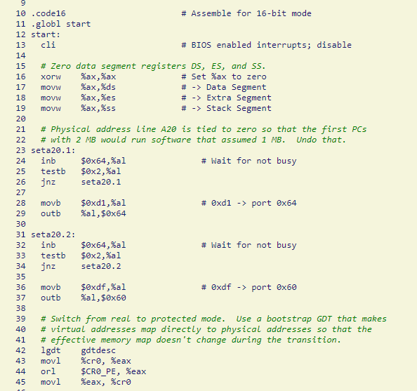
XV6 – bootasm.S
zero previous data segment registers and other related registers.
•
Then we ENABLE A20.
As we are in real mode, the ability of addressing is 20-bit address.
To enable 32-bit addressing. We need to send 2 binary code to the computer to enable A20.
In real mode, CS and IP is combined to find the physical address, which we call this is segment address.
Notes:
gdt

Slide 22
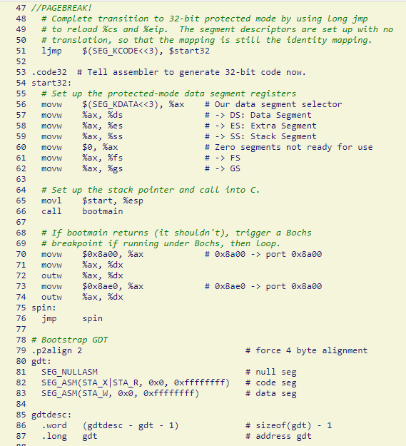
XV6 – bootasm.S
Then let’s go to the 32-bit world.
•
we set %esp points to the address of $start
Call bootmain.c
It should not return from bootmain
If returns it tries to debug
It is just a temporary GDT used for bootloader.
Notes:
gdt

Slide 23
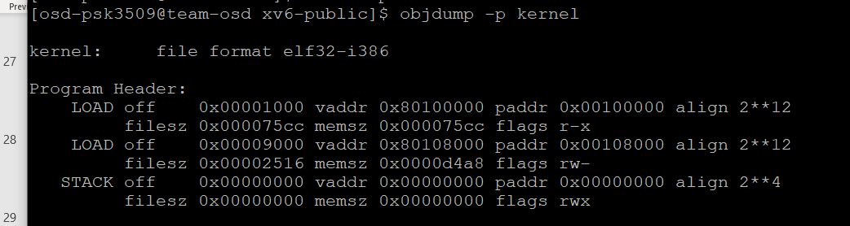
XV6 – bootmain.c
0905 struct elfhdr {
0906 uint magic;
0907 uchar elf[12];
0908 ushort type;
0909 ushort machine;
0910 uint version;
0911 uint entry;
0912 uint phoff;
0913 uint shoff;
0914 uint flags;
0915 ushort ehsize;
0916 ushort phentsize;
0917 ushort phnum;
0918 ushort shentsize;
0919 ushort shnum;
0920 ushort shstrndx;
0921 };
0924 struct proghdr {
0925 uint type;
0926 uint off;
0927 uint vaddr;
0928 uint paddr;
0929 uint filesz;
0930 uint memsz;
0931 uint flags;
0932 uint align;
0933 };
Kernel will be in ELF (Executable and Linkable Format)
The ELF header contains all of the relevant information required to load an ELF executable
Read the ELF Header located at the very beginning.

Slide 24
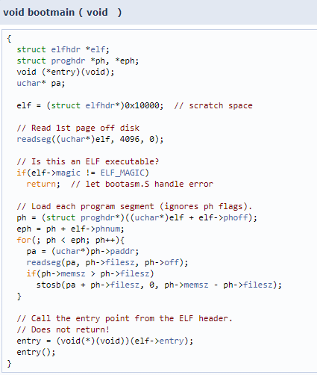
XV6 – bootmain.c
Verify that the file starts with the ELF magic number (4 bytes)
Read the ELF executable's program headers.
Parse the program headers to determine the number of program segments that must be loaded.
Copy the segment data from the file offset specified by the p_offset member to the virtual memory address specified by the p_vaddr member.
The size of the segment in the file is contained in the p_filesz member.
The p_memsz member specifies the size the segment occupies in memory.
If the p_filesz and p_memsz members differ, this indicates that the segment is padded with zeros.

Slide 25

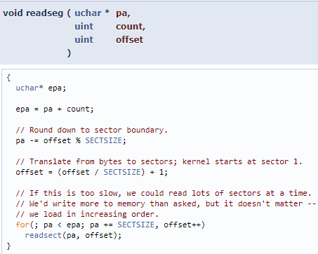
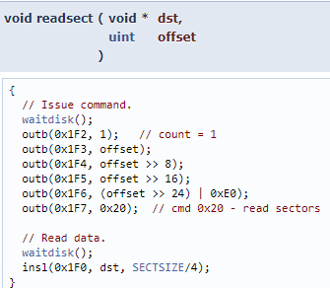
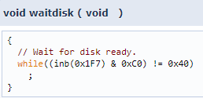
XV6 – bootmain.c
// store value of '1' into the number of sectors register
// set the sector offset registers
// Set ready register
//insl: write buffer gets written 128 times from the register via CPU.

Slide 26
2GB + 4 MB
2GB
enrypgdir
First Address Space
bootasm.s
4 MB
0
4 MB
0
bootmain.c
Virtual Memory
Physical Memory
entry
entrypgdir
paging and stack
main()
Defines a Page and creates a page directory entrypgdir
Virtual to Physical address Mapping is done
Turns on paging and set stack pointer for kernel
Kernel execution starts

Slide 27
The First Address Space
The xv6 bootloader loads the kernel code in low physical memory (starting at 1MB, after leaving the first 1MB for use by I/O devices), and starts executing the kernel at entry.
The entry code first turns on support for large pages (4MB), and sets up the first page table entrypgdir.
The first entry of this page table maps virtual addresses [0, 4MB] to physical addresses [0,4MB], to enable the entry code that resides in the low virtual address space to run.
The second entry in this page table is easier to follow: it maps [KERNBASE, KERNBASE+4MB] to[0, 4MB], to enable the first 4MB of kernel code in the high virtual address space to run after MMU is turned on.

Slide 28
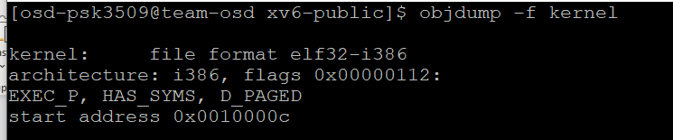
The First Address Space
1036 # By convention, the _start symbol specifies the ELF entry point.
1037 # Since we haven’t set up virtual memory yet, our entry point is
1038 # the physical address of ’entry’.
1039 .globl _start
1040 _start = V2P_WO(entry)
1041
1042 # Entering xv6 on boot processor, with paging off.
1043 .globl entry
1044 entry:
1045 # Turn on page size extension for 4Mbyte pages
1046 movl %cr4, %eax
1047 orl $(CR4_PSE), %eax
1048 movl %eax, %cr4
1049 # Set page directory
1050 movl $(V2P_WO(entrypgdir)), %eax
1051 movl %eax, %cr3
The xv6 bootloader loads the kernel code in low physical memory (starting at 1MB, after leaving the first 1MB for use by I/O devices), and starts executing the kernel at entry.
2. The entry code first turns on support for large pages (4MB), and sets up the first page table entrypgdir.
0207 #define KERNBASE 0x80000000 // First kernel virtual address
0210 #define V2P(a) (((uint) (a)) − KERNBASE)
0213 #define V2P_WO(x) ((x) − KERNBASE) // same as V2P, but without casts

Slide 29
1300 // The boot page table used in entry.S and entryother.S.
1301 // Page directories (and page tables) must start on page boundaries,
1302 // hence the __aligned__ attribute.
1303 // PTE_PS in a page directory entry enables 4Mbyte pages.
1304
1305 __attribute__((__aligned__(PGSIZE)))
1306 pde_t entrypgdir[NPDENTRIES] = {
1307 // Map VA’s [0, 4MB) to PA’s [0, 4MB)
1308 [0] = (0) | PTE_P | PTE_W | PTE_PS,
1309 // Map VA’s [KERNBASE, KERNBASE+4MB) to PA’s [0, 4MB)
1310 [KERNBASE>>PDXSHIFT] = (0) | PTE_P | PTE_W | PTE_PS,
1311 };
entrypgdir
The first entry of this page table table maps virtual addresses [0, 4MB] to physical addresses [0,4MB], to enable the entry code that resides in the low virtual address space to run.
The second entry in this page table is easier to follow: it maps [KERNBASE, KERNBASE+4MB] to[0, 4MB], to enable the first 4MB of kernel code in the high virtual address space to run after MMU is turned on.
2GB + 4 MB
2GB
4 MB
0
4 MB
0
Virtual Memory
Physical Memory

Slide 30
Paging and Stack
1052 # Turn on paging.
1053 movl %cr0, %eax
1054 orl $(CR0_PG|CR0_WP), %eax
1055 movl %eax, %cr0
1056
1057 # Set up the stack pointer.
1058 movl $(stack + KSTACKSIZE), %esp
1059
1060 # Jump to main(), and switch to executing at
1061 # high addresses. The indirect call is needed because
1062 # the assembler produces a PC−relative instruction
1063 # for a direct jump.
1064 mov $main, %eax
1065 jmp *%eax
1066
1067 .comm stack, KSTACKSIZE
Once a pointer to this page table is stored in CR3, MMU is turned on, the entry code creates a stack, and jumps to the main function in the kernel’s C code (line 1217).

Slide 31
Creating the first Process
1216 int
1217 main(void)
1218 {
1219 kinit1(end, P2V(4*1024*1024)); // phys page allocator
1220 kvmalloc(); // kernel page table
1221 mpinit(); // detect other processors
1222 lapicinit(); // interrupt controller
1223 seginit(); // segment descriptors
1224 picinit(); // disable pic
1225 ioapicinit(); // another interrupt controller
1226 consoleinit(); // console hardware
1227 uartinit(); // serial port
1228 pinit(); // process table
1229 tvinit(); // trap vectors
1230 binit(); // buffer cache
1231 fileinit(); // file table
1232 ideinit(); // disk
1233 startothers(); // start other processors
1234 kinit2(P2V(4*1024*1024), P2V(PHYSTOP)); // must come after startothers()
1235 userinit(); // first user process
1236 mpmain(); // finish this processor’s setup
1237 }
1238
Initializes several devices and subsystems,
it creates the first process by calling userinit

